Slide 1
Algorithms
Mushtari Sadia

Slide 2
Minimum Spanning Tree
Prim’s and Kruskal’s Algorithm

Slide 3
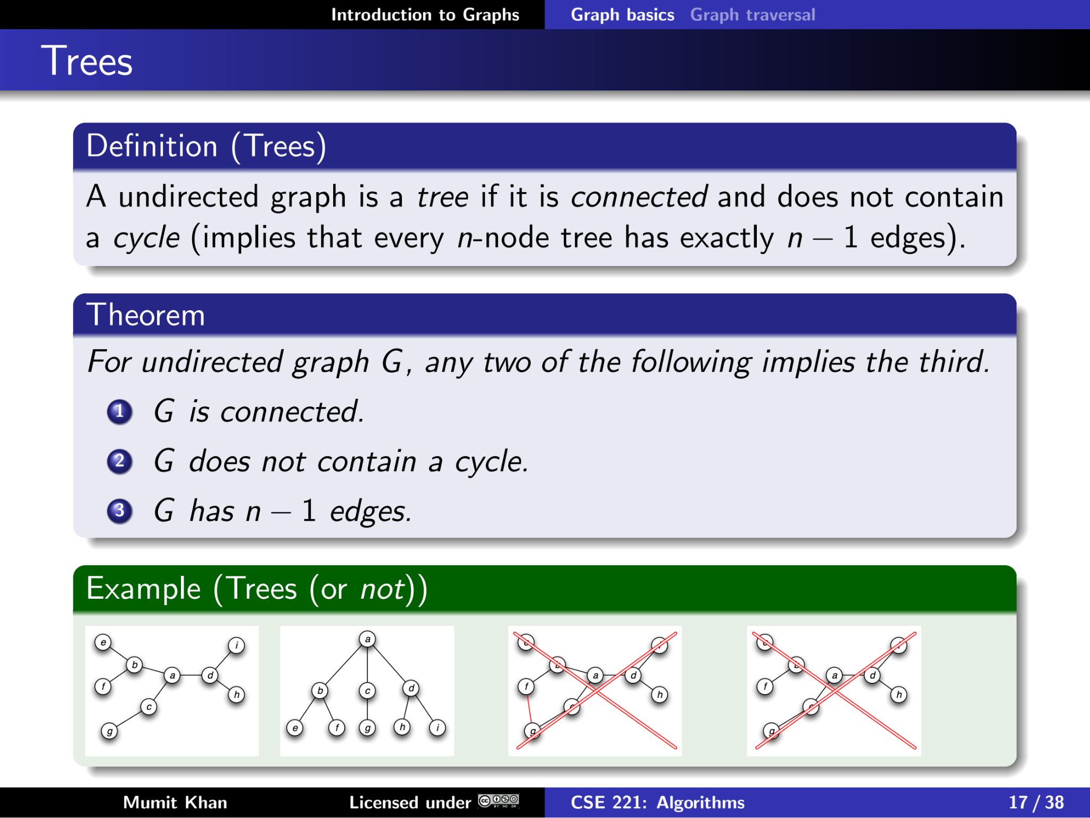
Recall

Slide 4
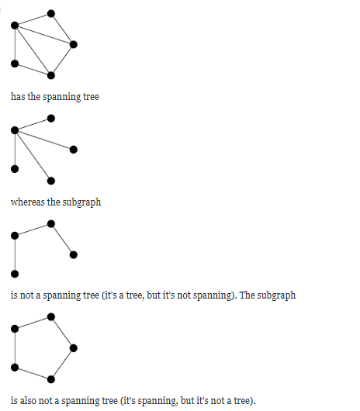
Difference Between Tree and Spanning Tree
A tree is a type of graph. A spanning tree is a subgraph of the graph that is a tree and hits every vertex.
This graph:

Slide 5
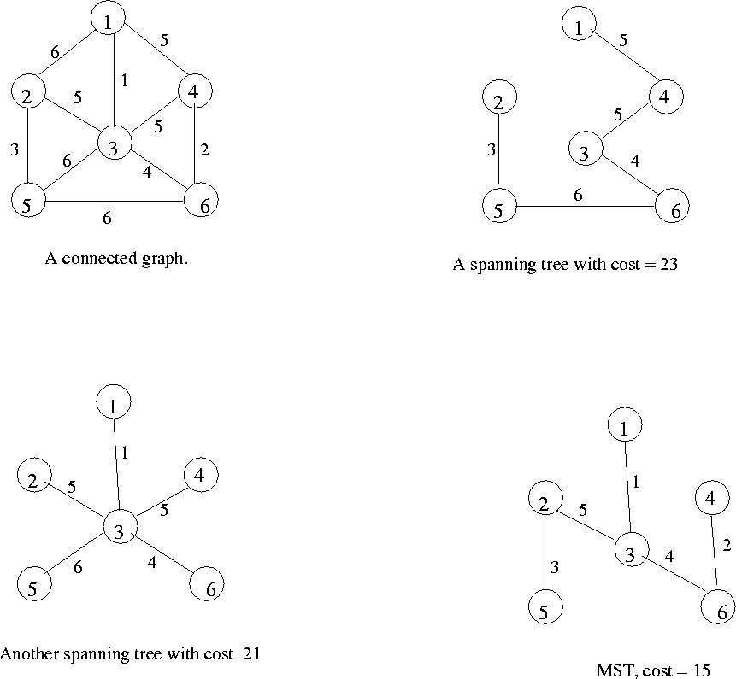
Minimum Spanning Tree (MST)
Minimum spanning tree is the spanning tree where the cost is minimum among all the spanning trees.

Slide 6
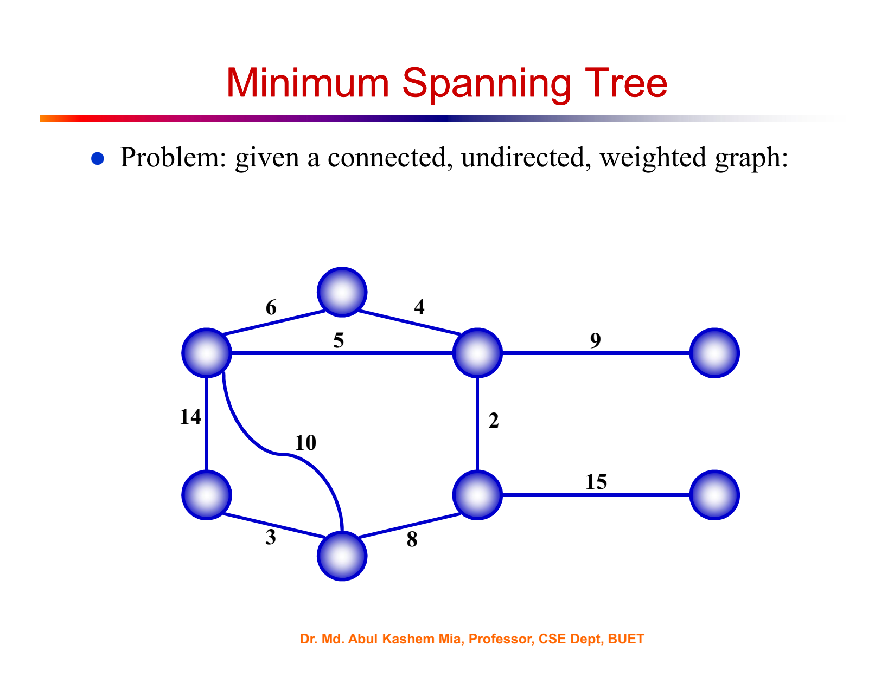

Slide 7
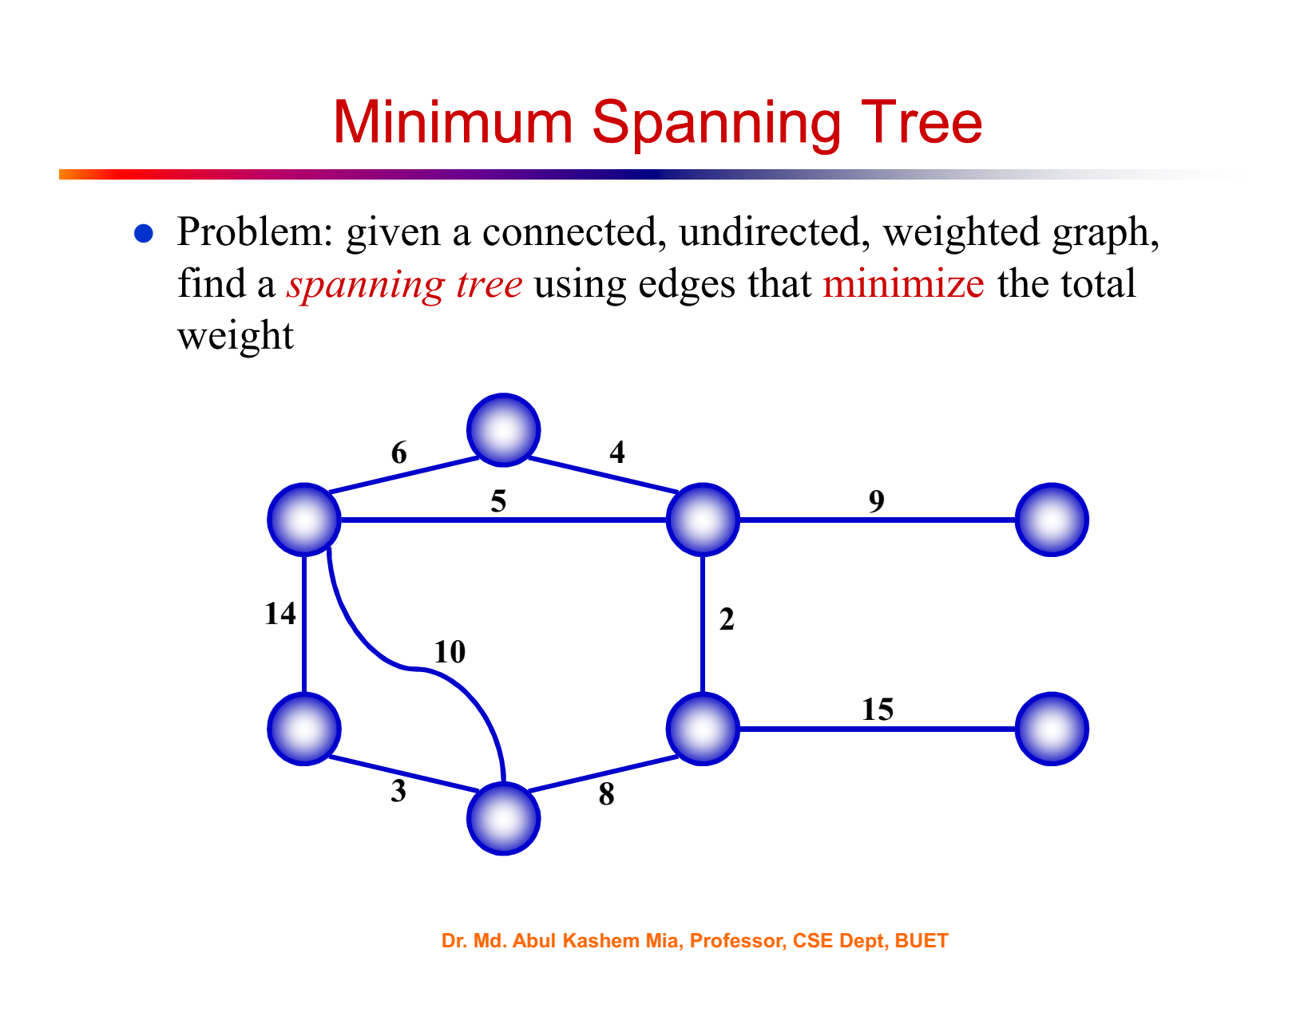

Slide 8
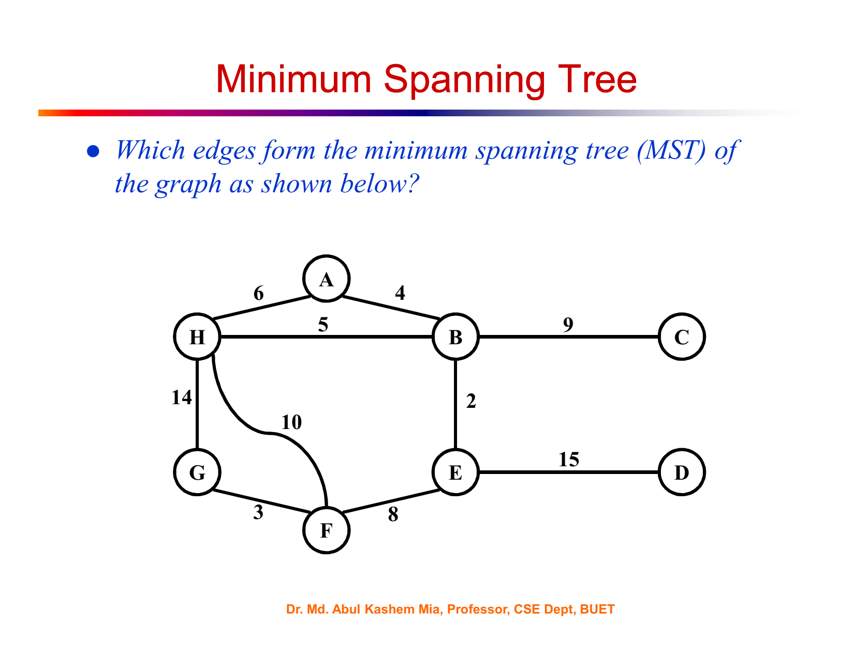

Slide 9
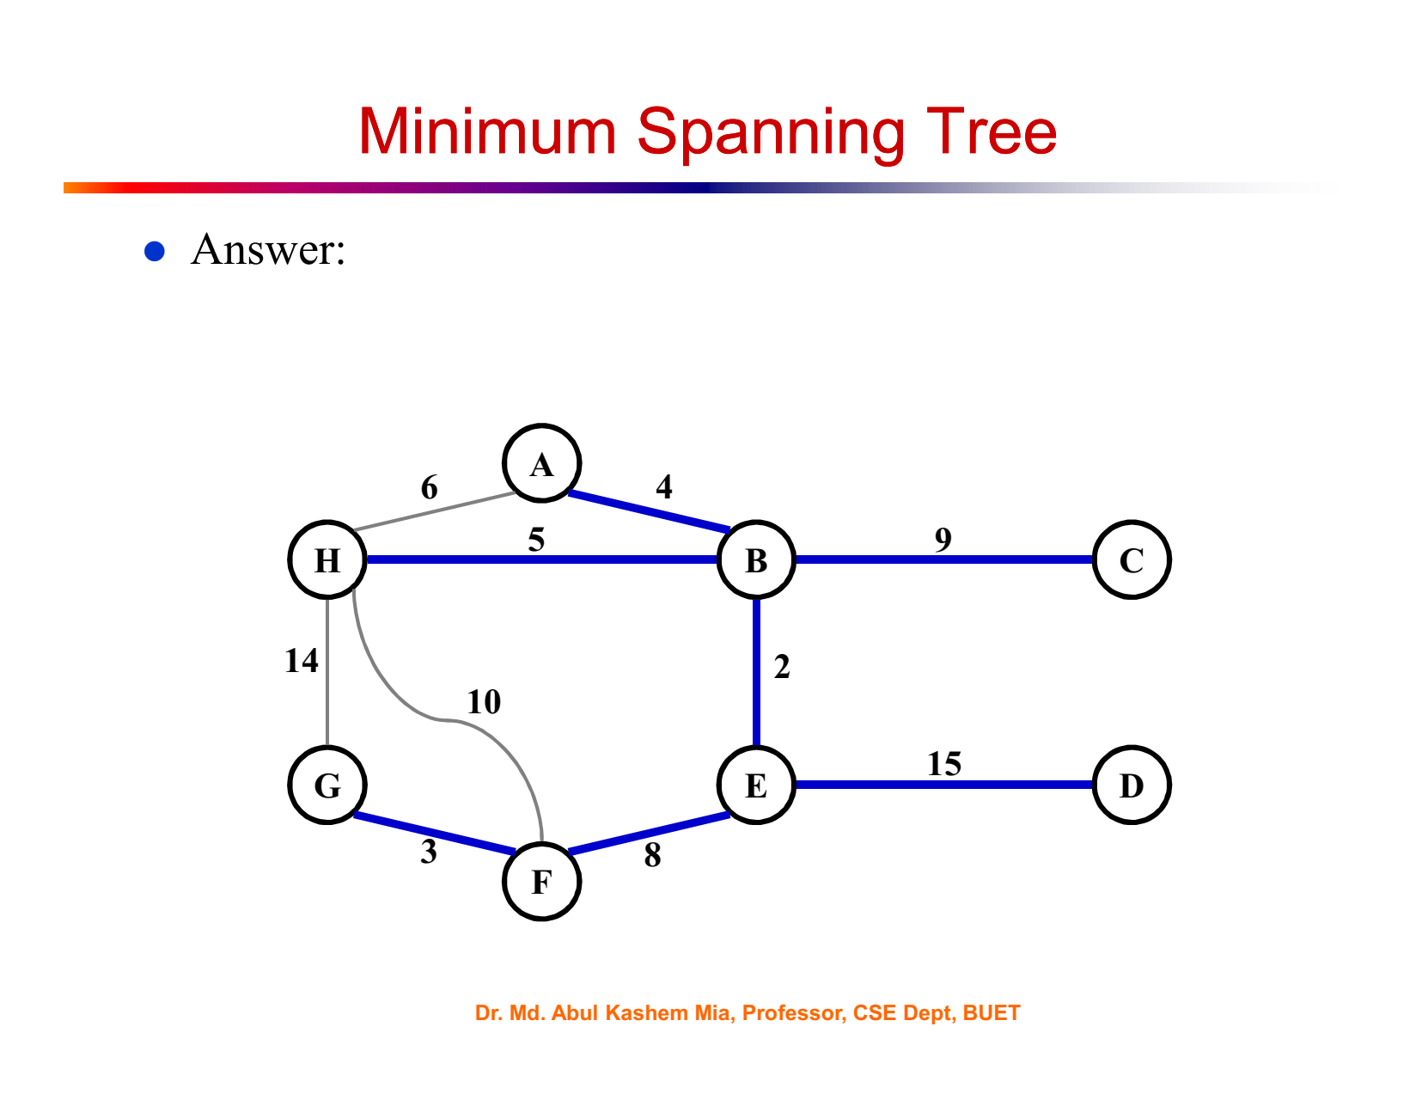

Slide 10
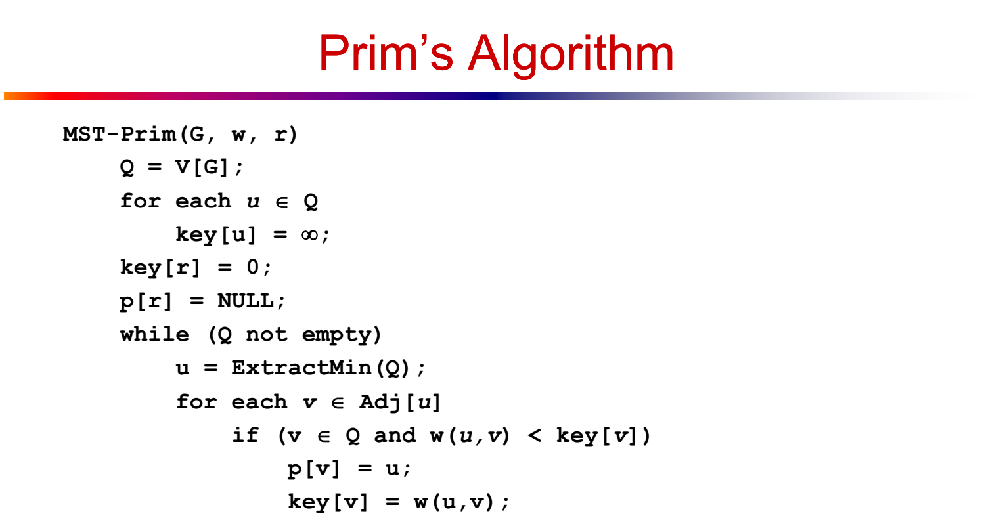

Slide 11
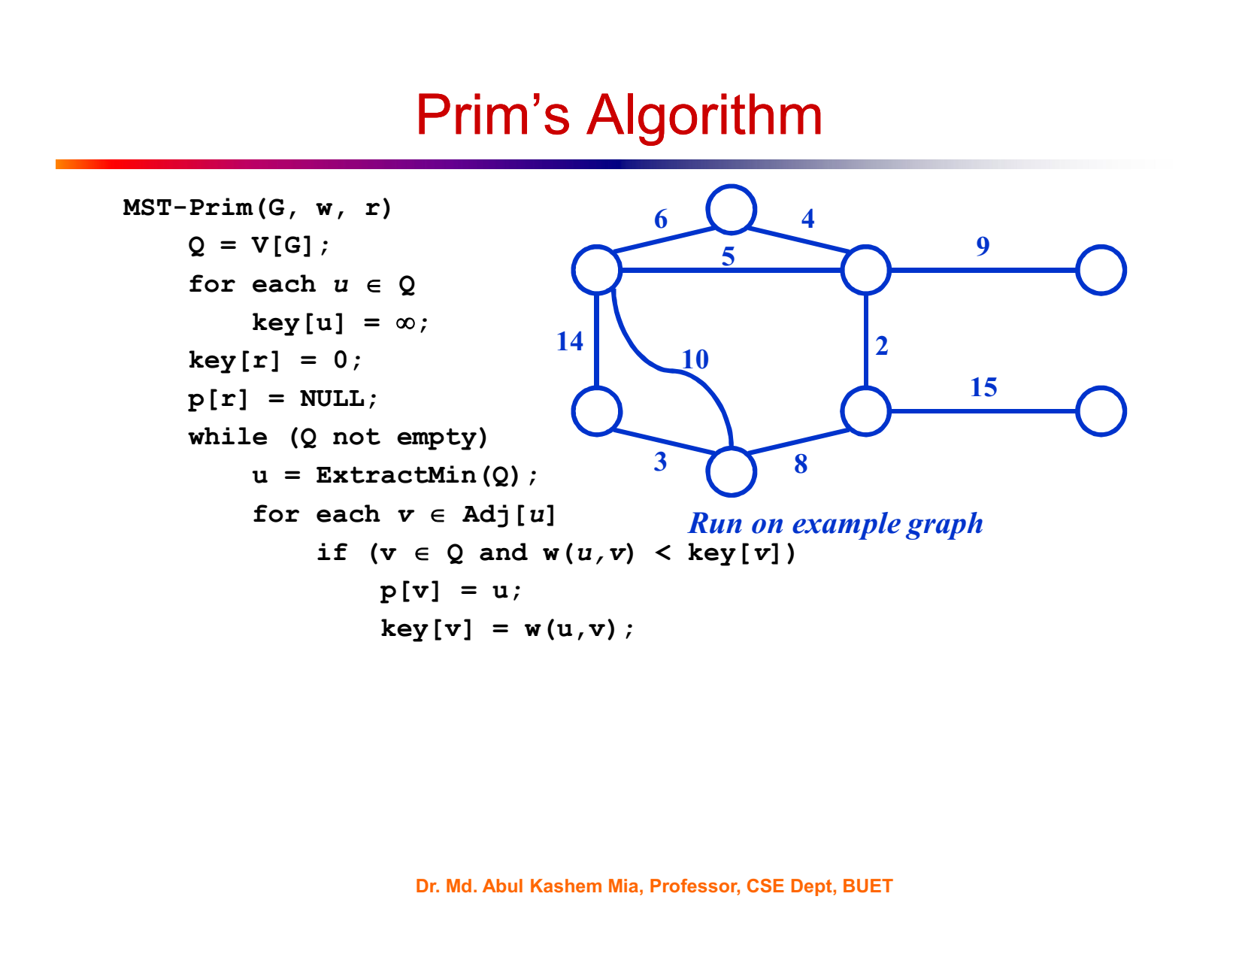

Slide 12


Slide 13
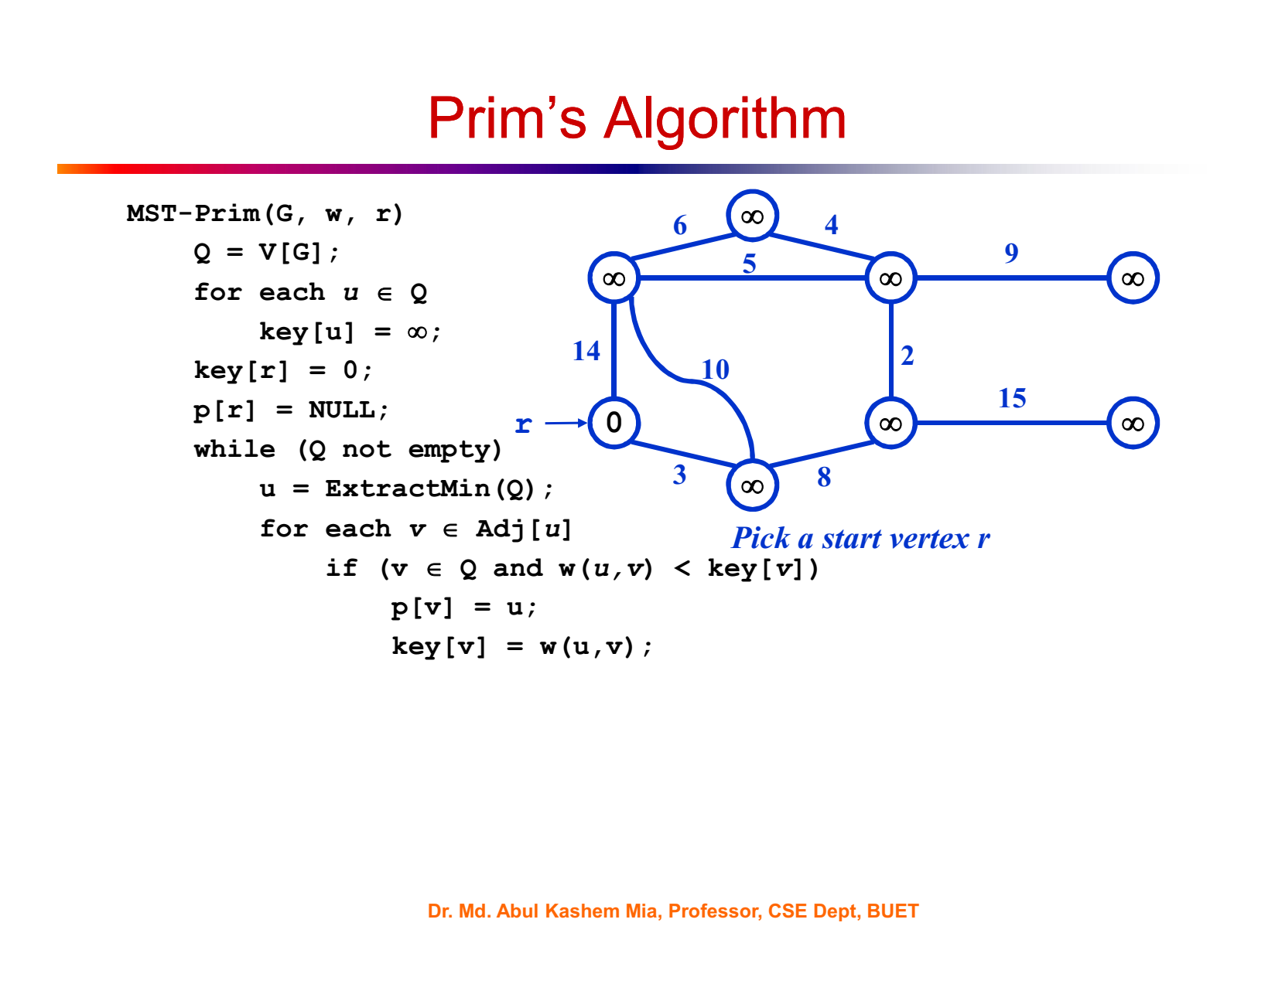

Slide 14
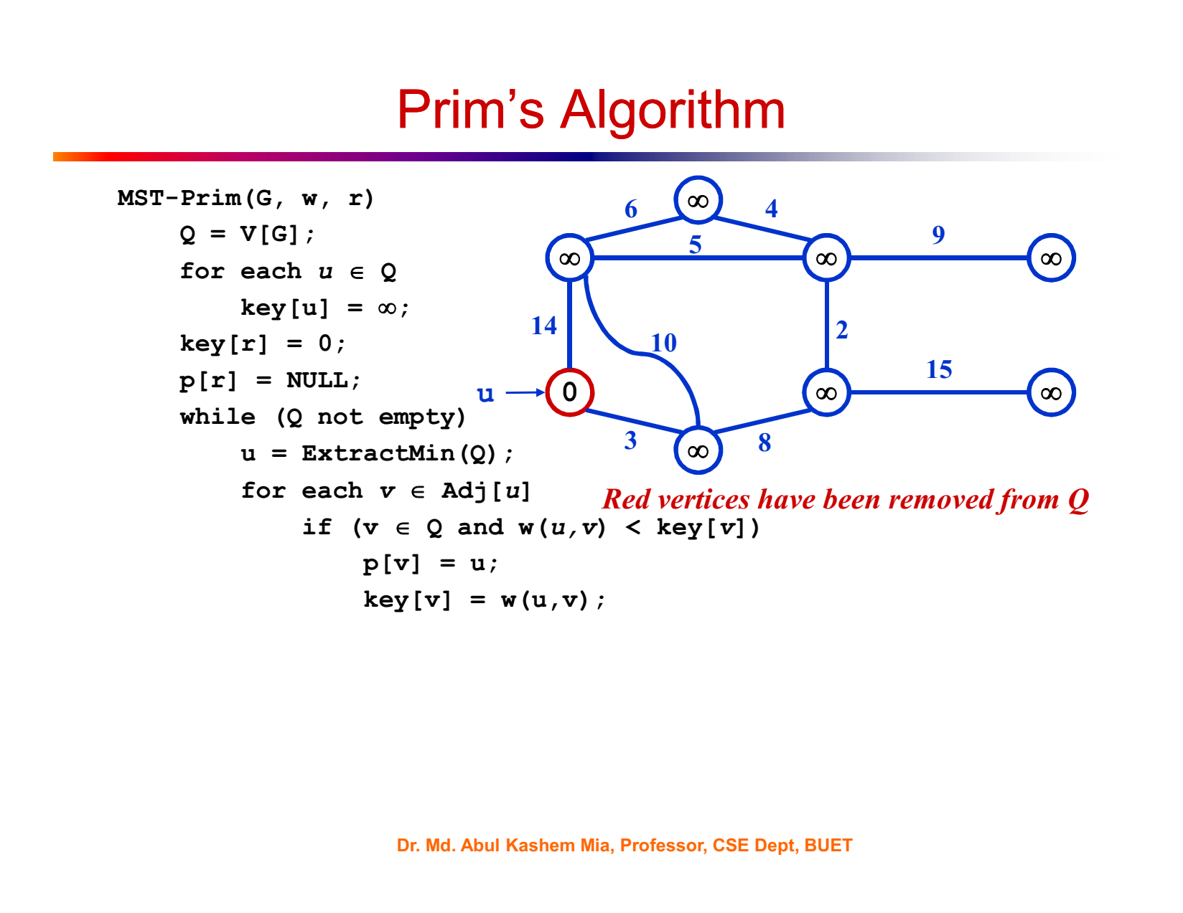

Slide 15


Slide 16
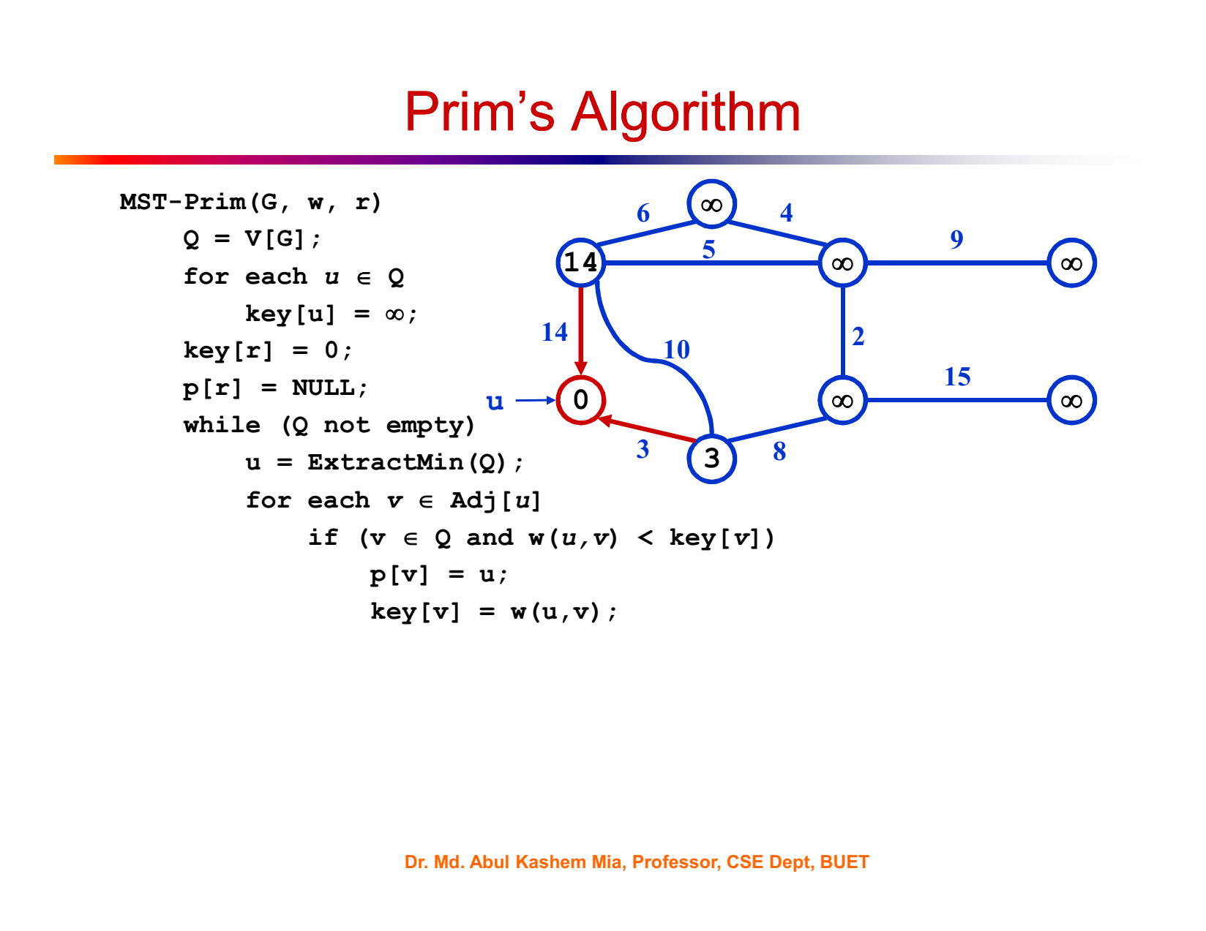

Slide 17
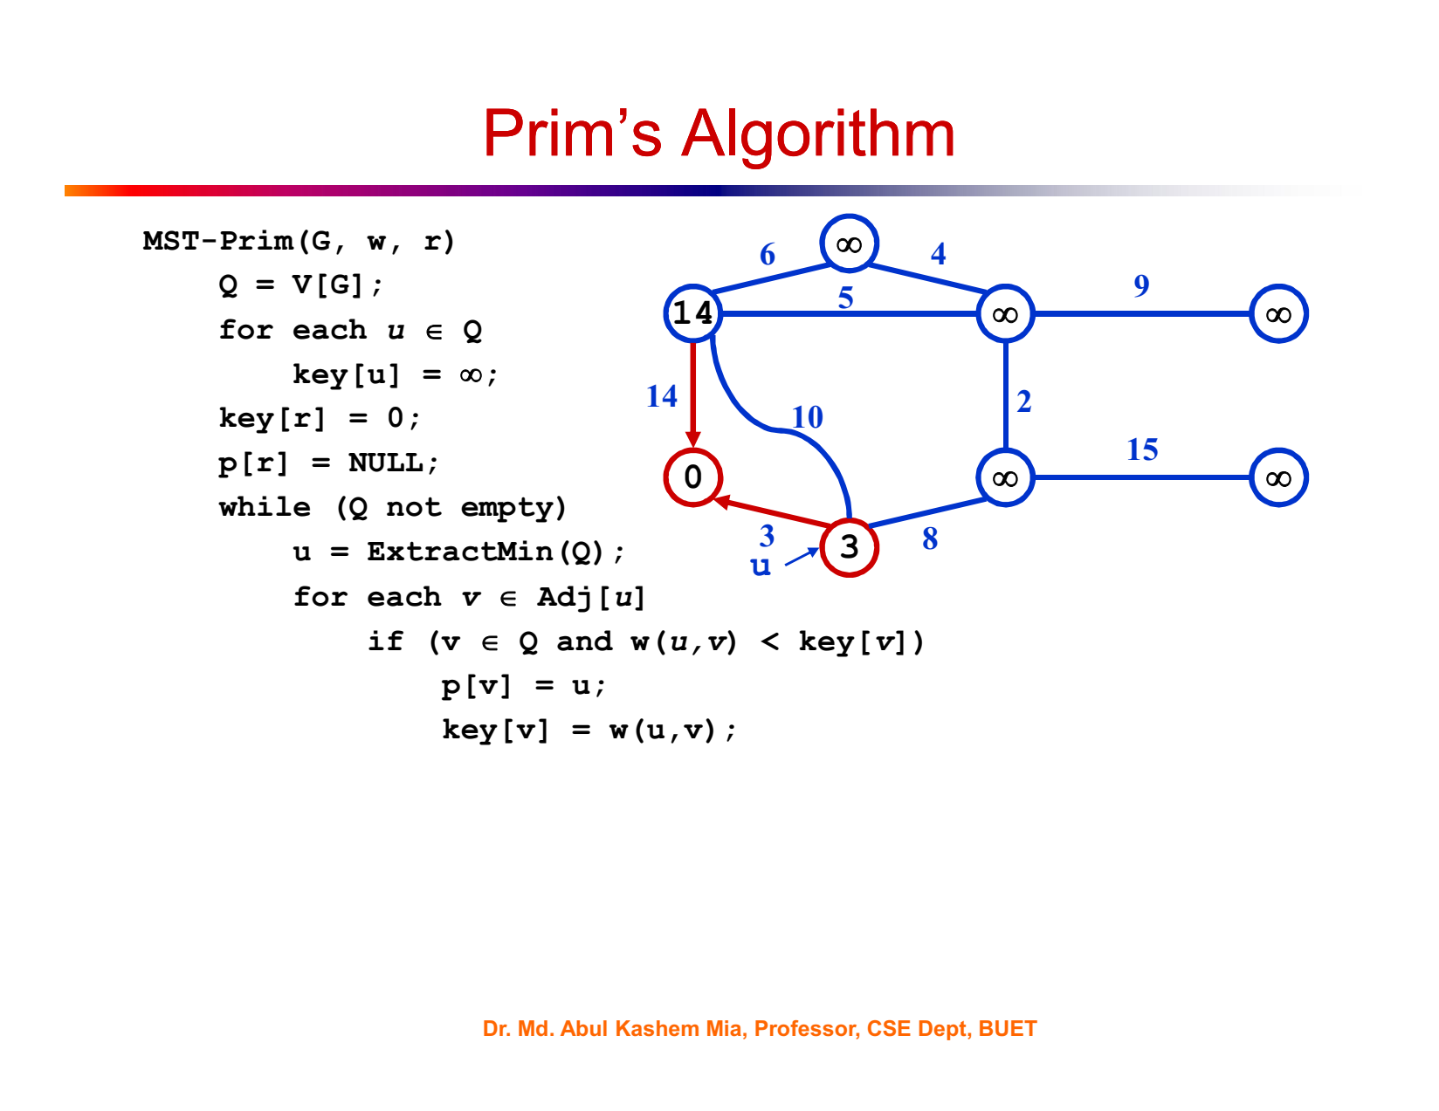

Slide 18
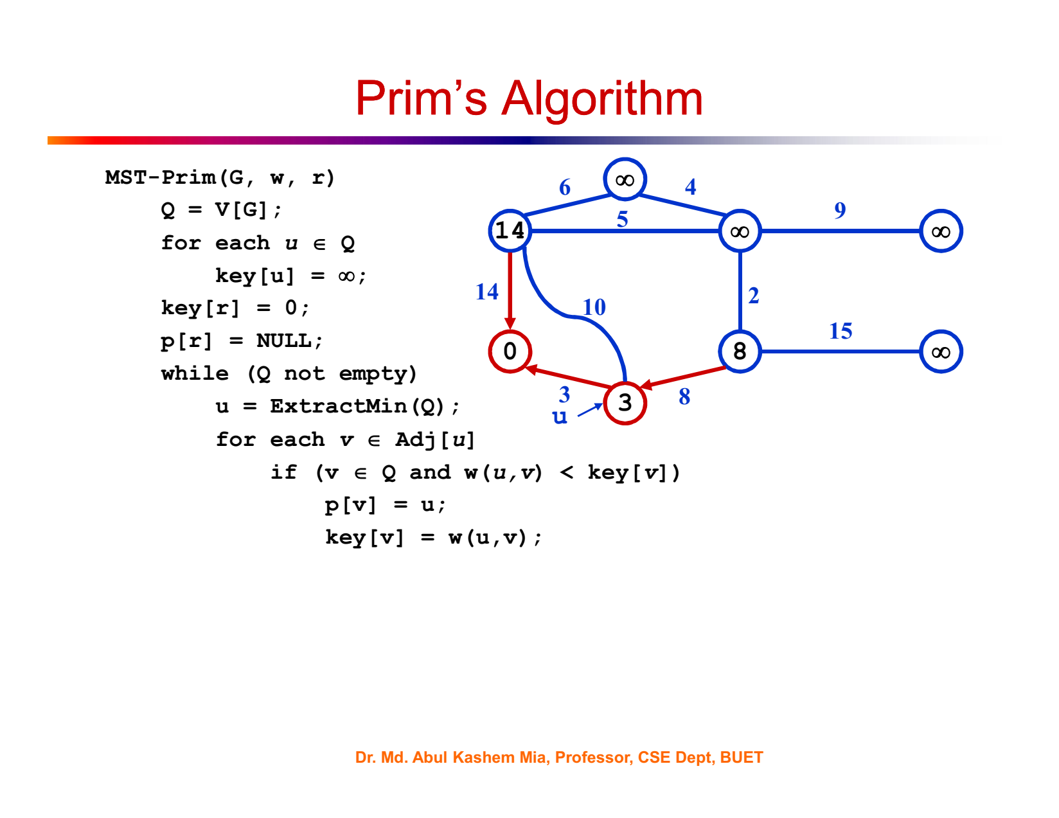

Slide 19
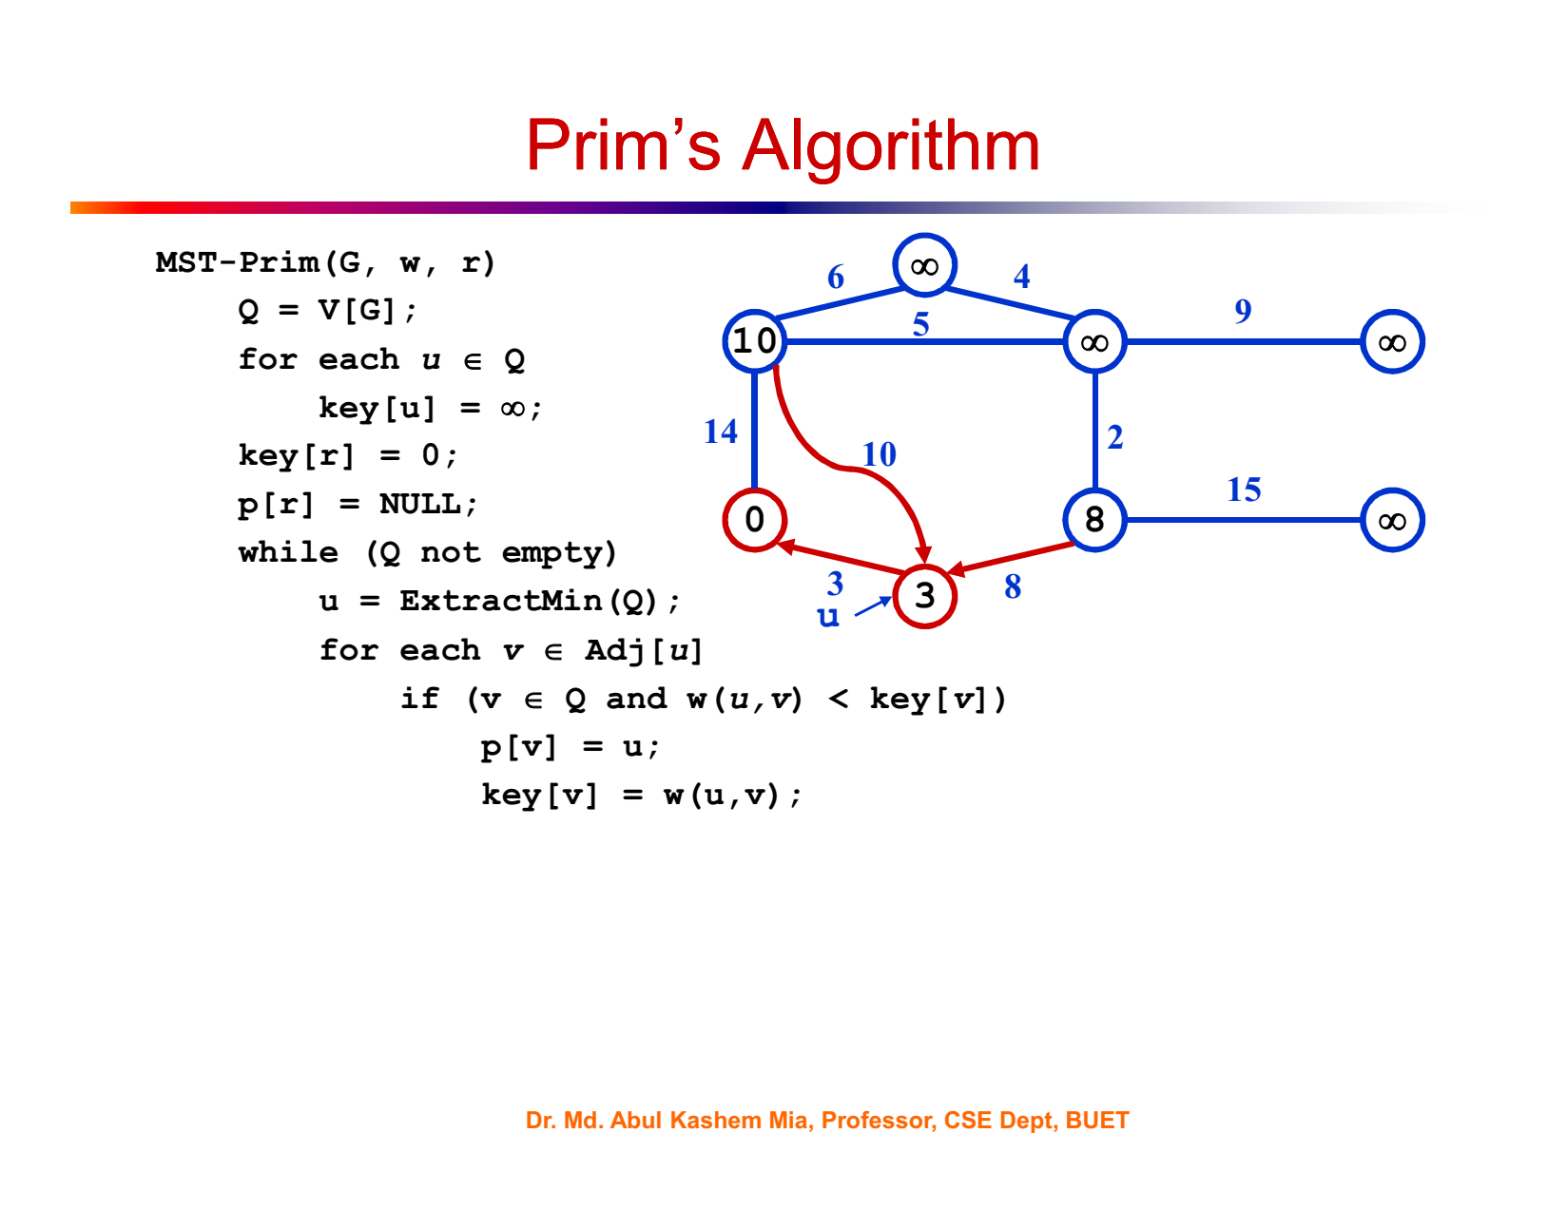

Slide 20
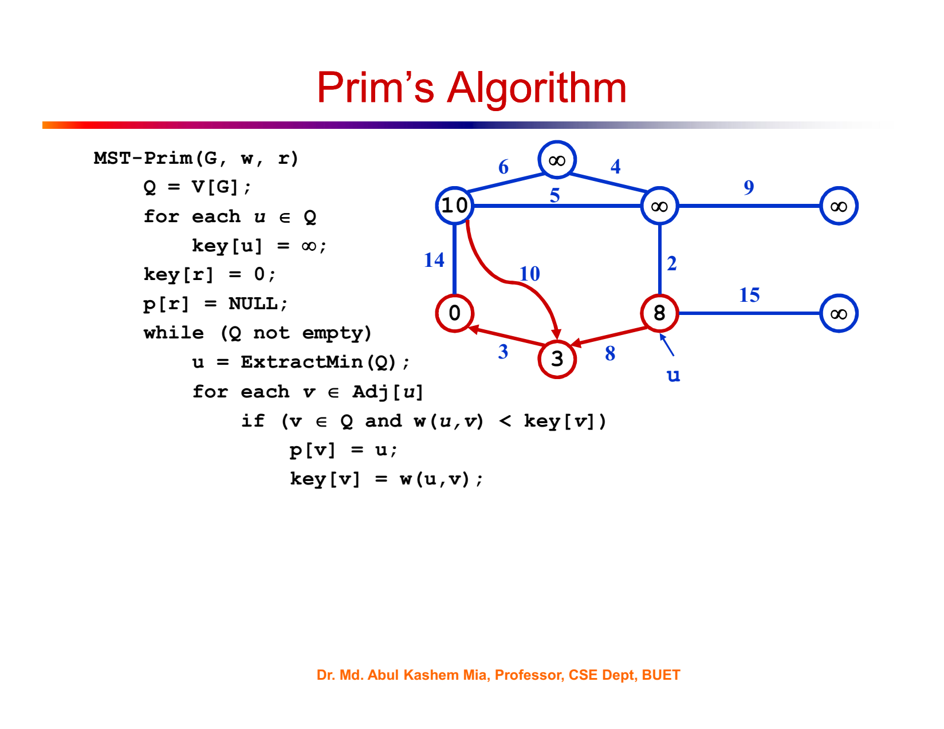

Slide 21
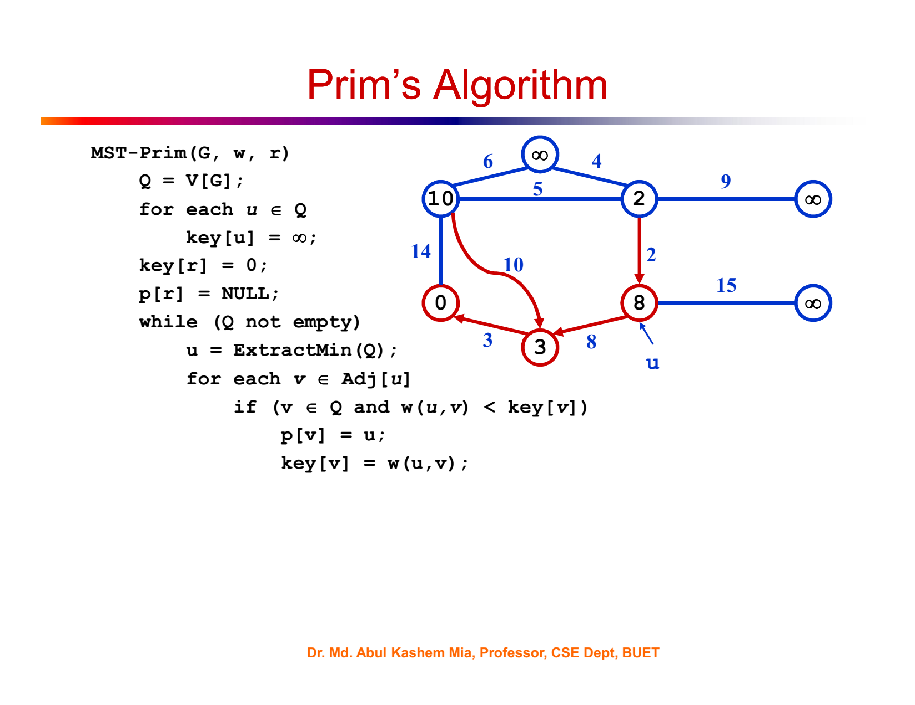

Slide 22


Slide 23
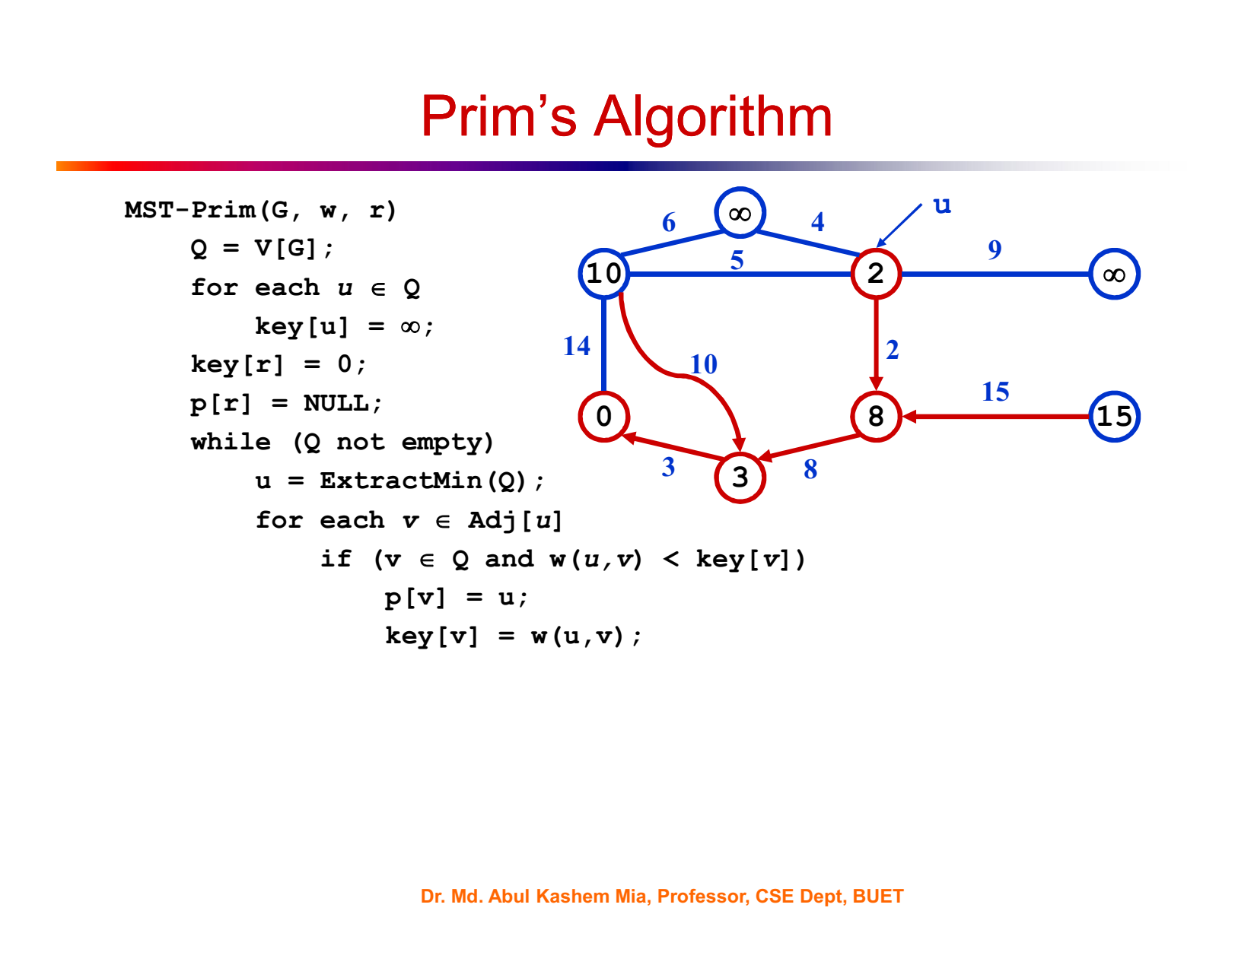

Slide 24
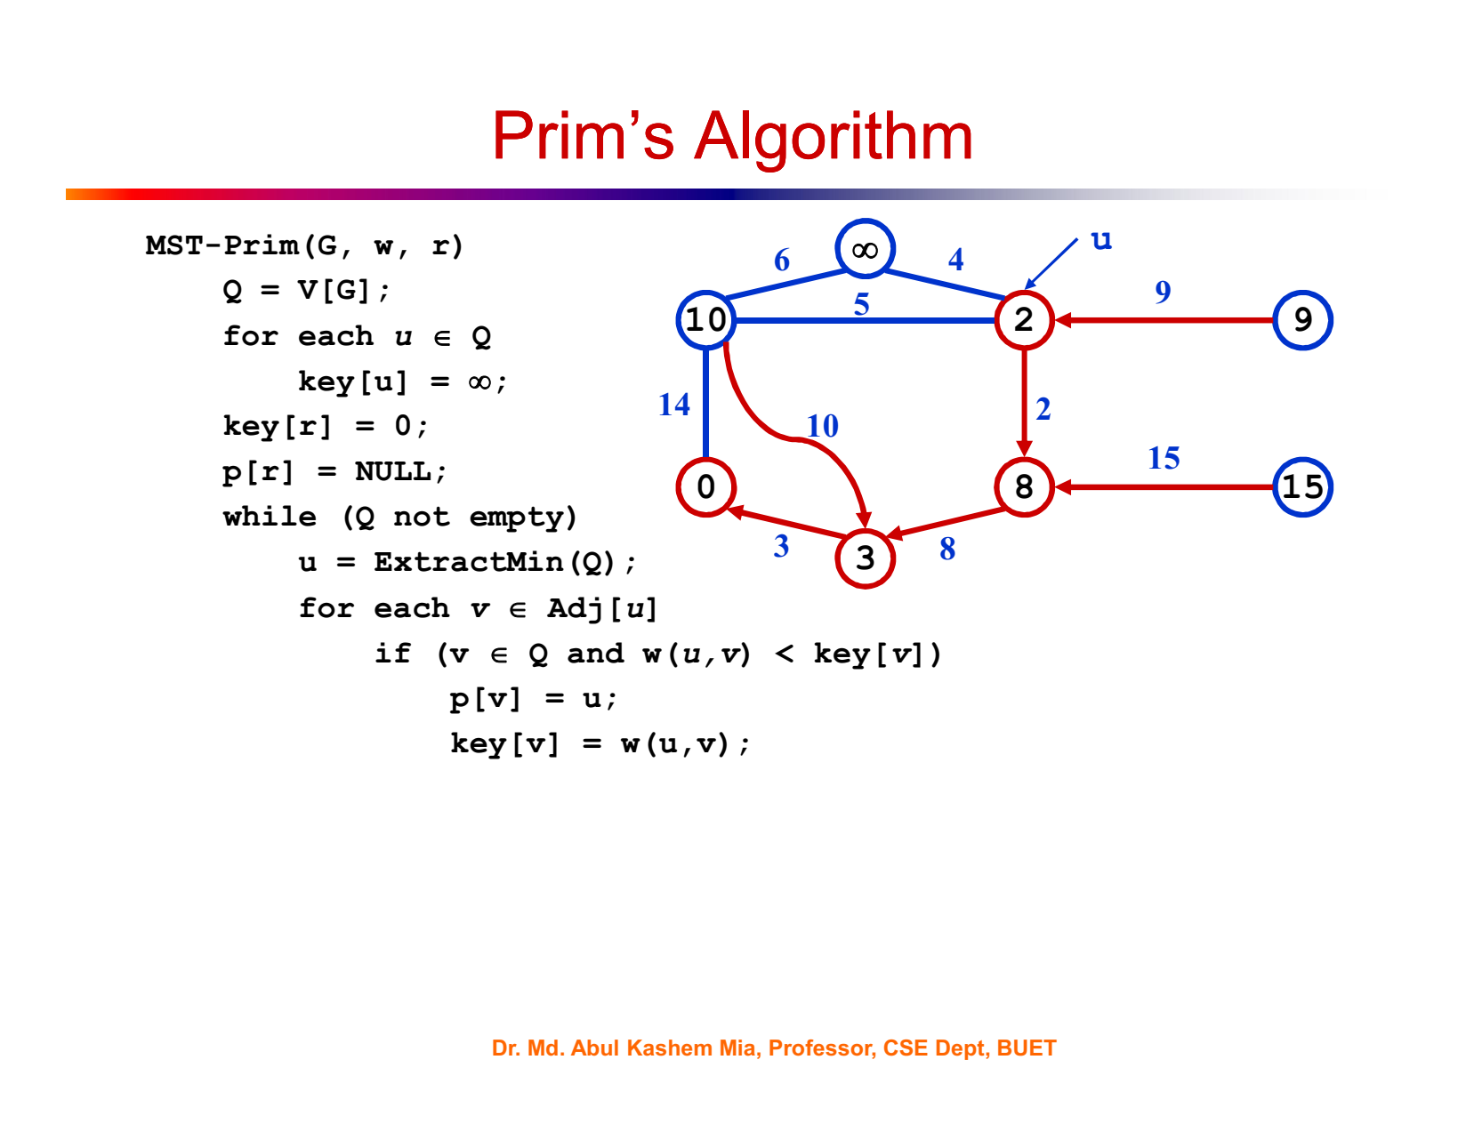

Slide 25


Slide 26
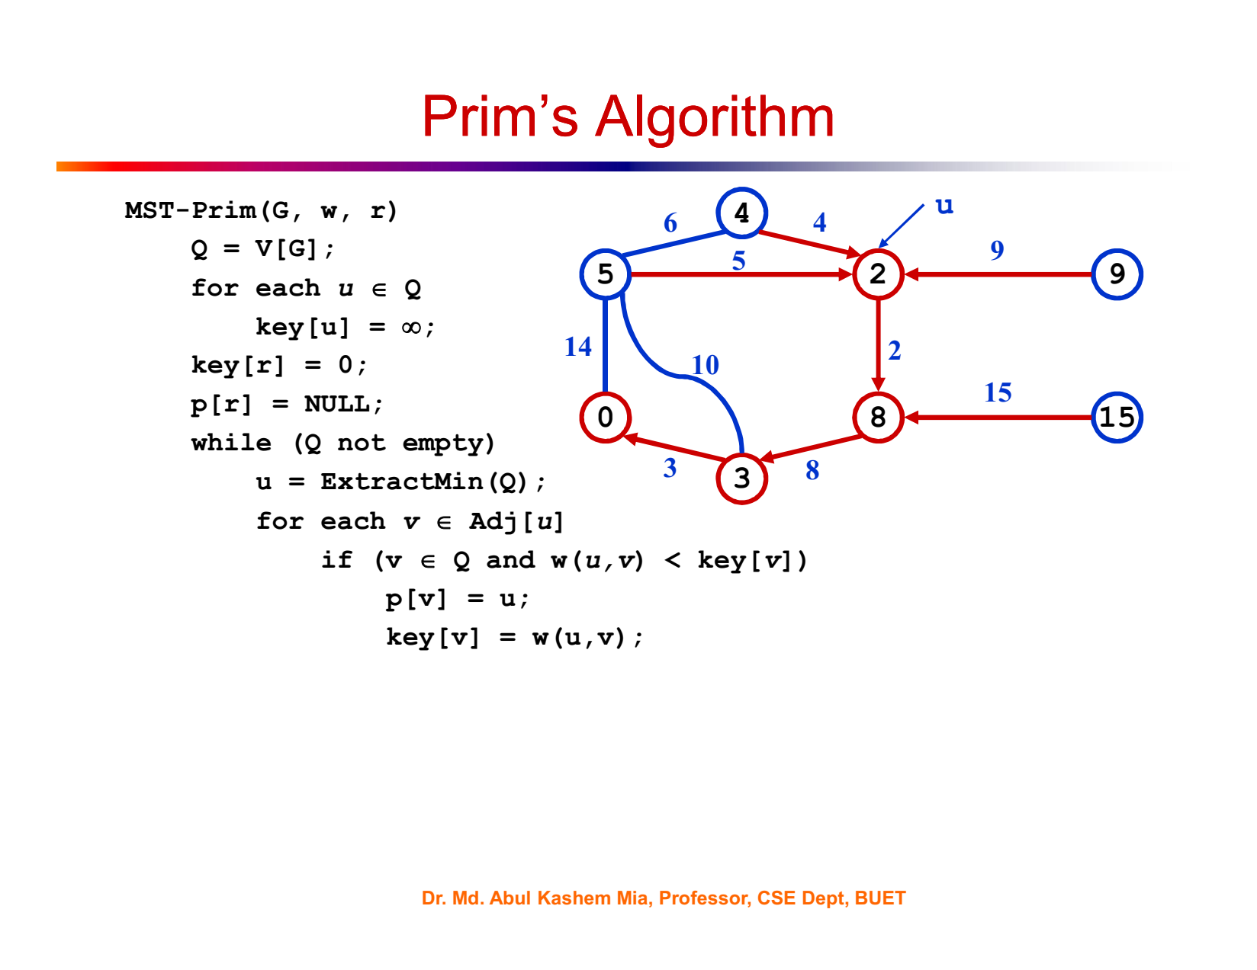

Slide 27
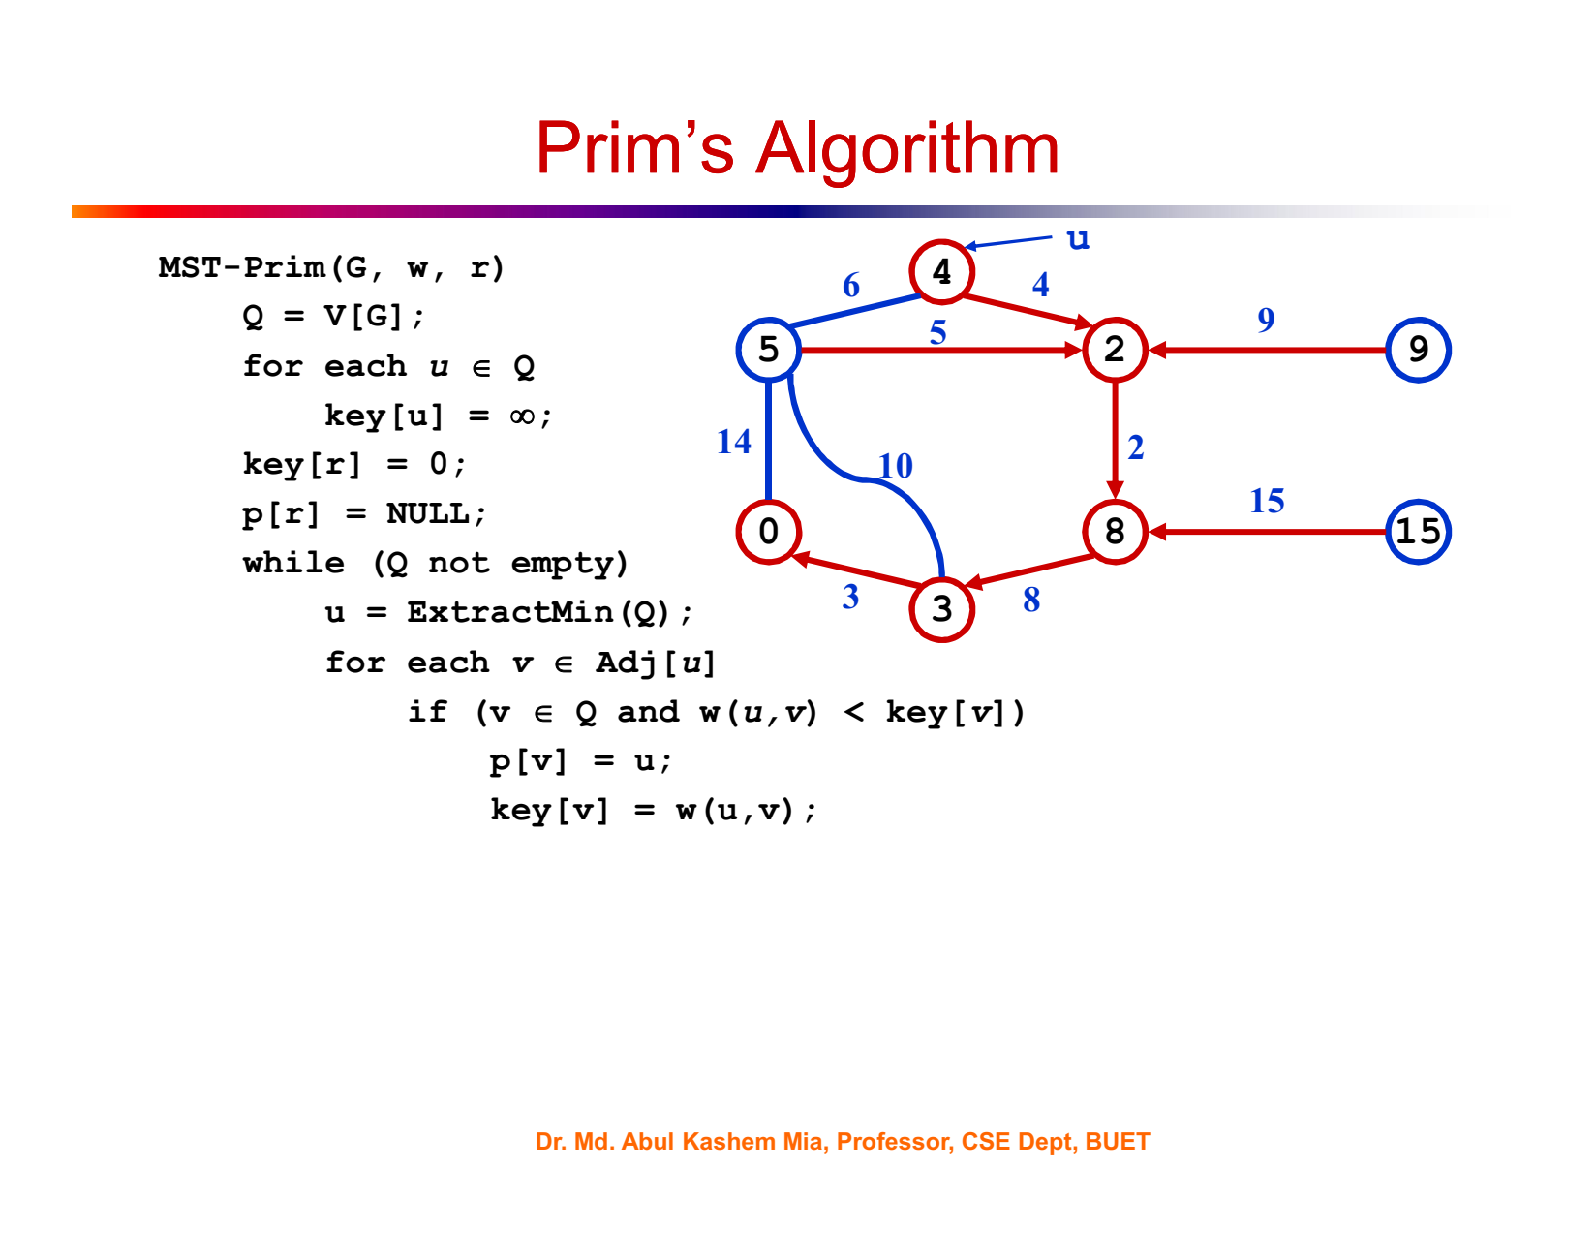

Slide 28
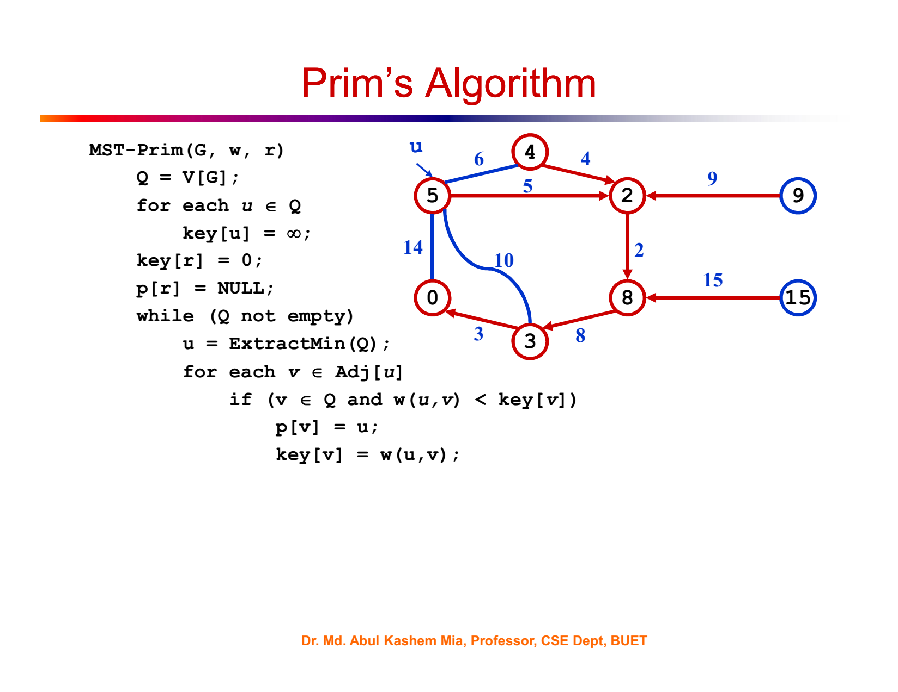

Slide 29
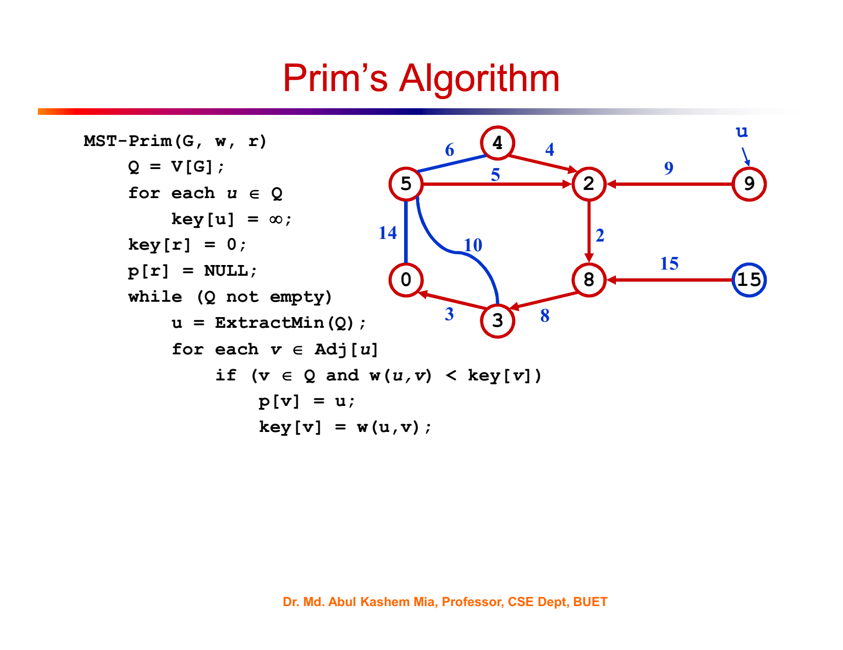

Slide 30
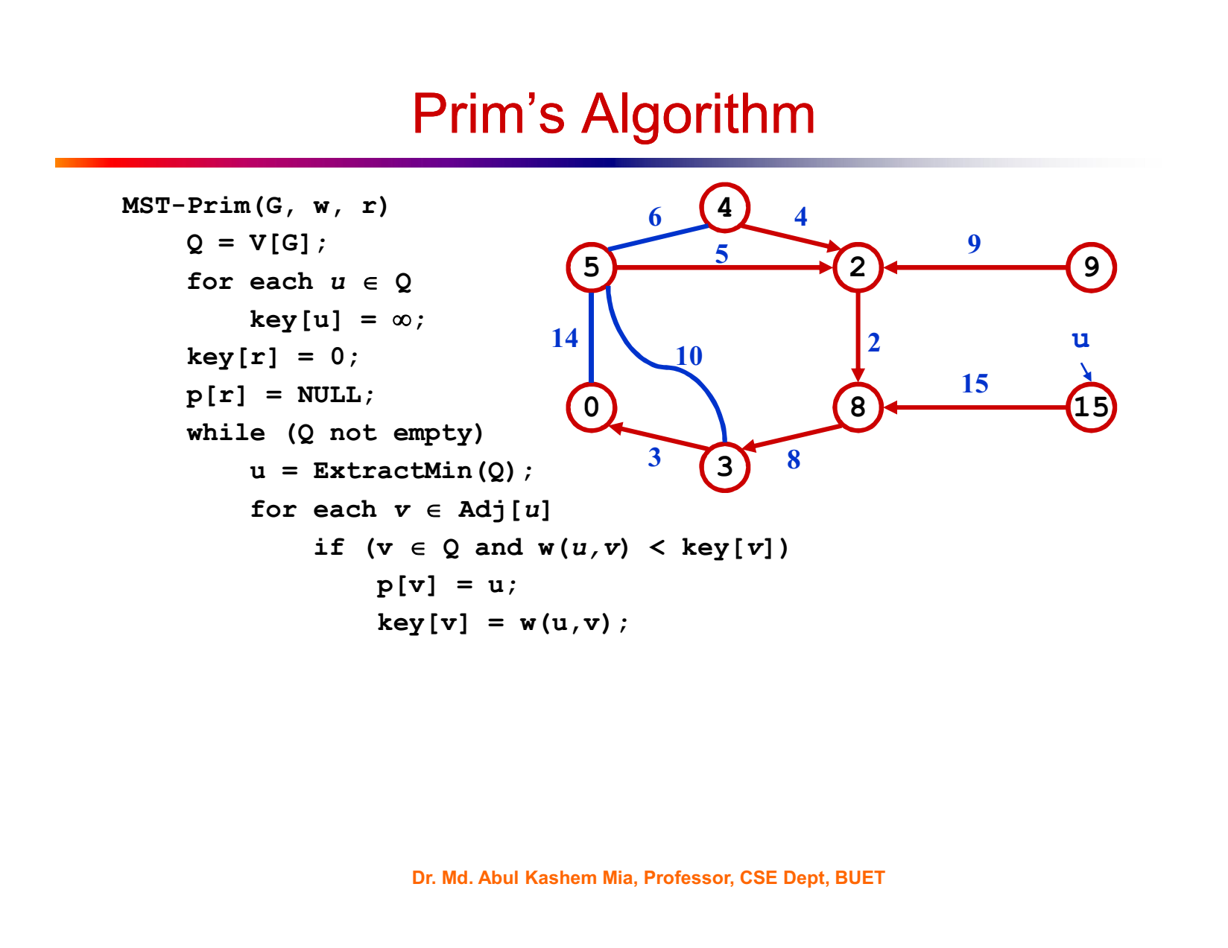

Slide 31
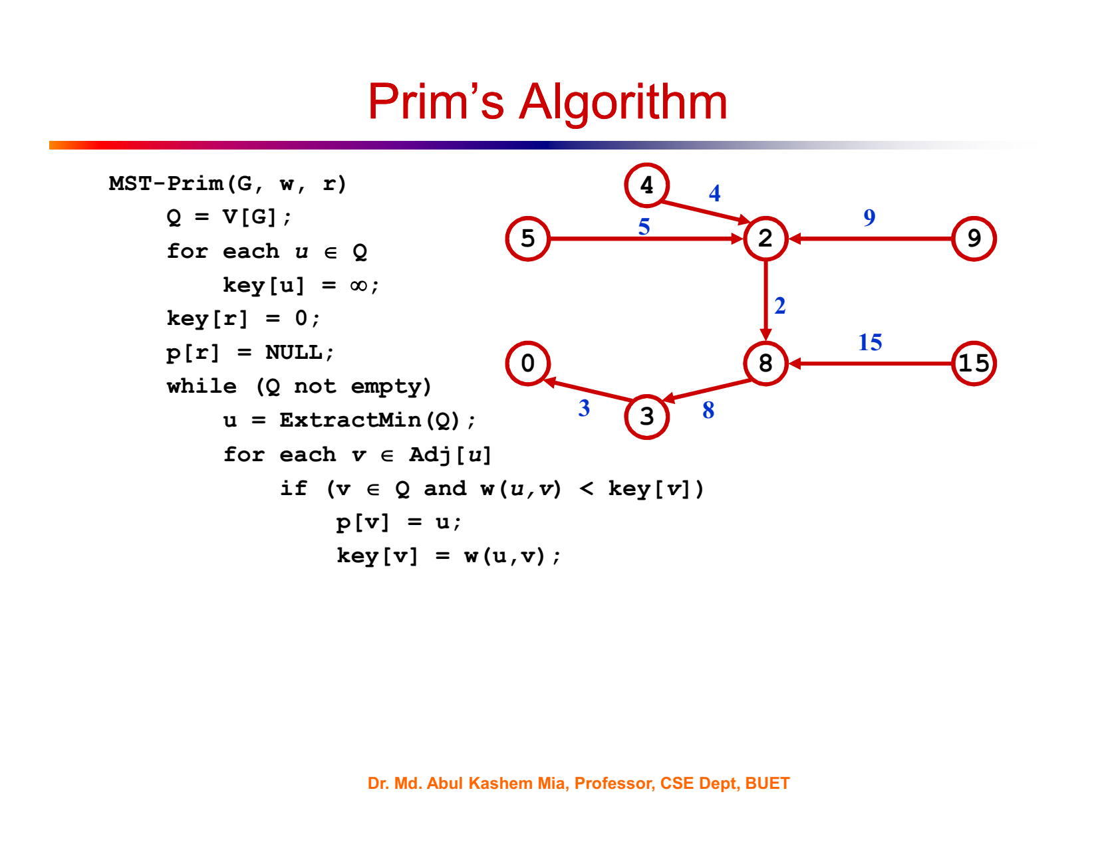

Slide 32
import heapq
def prim(graph):
# Select any starting vertex. For simplicity, we choose the first vertex in the graph.
start_vertex = list(graph.keys())[0]
# Keep track of visited vertices and the edges in the MST.
num_vertices = len(graph)
visited = [False] * num_vertices
mst_edges = []
# Initialize the priority queue with edges from the starting vertex.
priority_queue = [(weight, start_vertex, neighbor) for neighbor, weight in graph[start_vertex].items()]
heapq.heapify(priority_queue)
visited[start_vertex] = True
while priority_queue:
weight, vertex_from, vertex_to = heapq.heappop(priority_queue)
if not visited[vertex_to]:
visited[vertex_to] = True
mst_edges.append((vertex_from, vertex_to, weight))
for neighbor, neighbor_weight in graph[vertex_to].items():
if not visited[neighbor]:
heapq.heappush(priority_queue, (neighbor_weight, vertex_to, neighbor))
return mst_edges

Slide 33
Example usage of Prim's algorithm:
graph = {
'A': {'B': 1, 'C': 4},
'B': {'A': 1, 'C': 2, 'D': 5},
'C': {'A': 4, 'B': 2, 'D': 1},
'D': {'B': 5, 'C': 1}
}
mst = prim(graph)
print(mst)
# Output: [('A', 'B', 1), ('B', 'C', 2), ('C', 'D', 1)]

